Slide 1


M.Tech Program
Advanced Industry Integrated Programs
Jointly offered by University and LTIMindTree
Review II
AI Voyage Planner: Context-Aware Travel Recommendations and Adaptive Scheduling
Team Member
S Syed ali Fathima
Crescent 2025-27
Knowledge partner | Implementation partner

Slide 2
Project Title - Calibri body 18
Introduction
Travel planning is often fragmented, requiring users to search multiple websites for destinations, hotels, transportation, and travel schedules.
Most travel recommendation systems provide generic or popularity-based suggestions rather than personalized recommendations.
Existing tourism platforms rarely consider a traveler's budget, available time, interests, and travel preferences simultaneously.
Travel plans are typically static and require manual modifications when weather conditions, transportation schedules, or attraction availability change.
AI Voyage Planner is proposed as a Generative AI and RAG-based intelligent travel assistant that provides personalized recommendations and dynamically adapts itineraries to changing travel conditions.

Slide 3
Project Title - Calibri body 18
Objective
To develop an AI-powered travel planning assistant for personalized tourism recommendations.
To understand user preferences including budget, travel duration, destination, and interests.
To retrieve relevant travel information using Retrieval-Augmented Generation (RAG). generate intelligent and personalized travel itineraries using Large Language Models.
To dynamically update travel schedules based on weather changes, transportation delays, and attraction availability.
To provide an interactive dashboard for seamless travel planning and management.

Slide 4
Project Title - Calibri body 18
Module name
User Preference & Trip Planning Module – Collects user details such as destination, budget, duration, interests, and travel preferences.
Tourism Data Management Module – Collects, cleans, and organizes tourism, attraction, hotel, transport, and carbon-related data.
RAG-Based Tourism Knowledge Module – Retrieves relevant tourism information from the knowledge base to support accurate AI responses.
Destination Recommendation Module – Recommends suitable destinations based on the user's preferences and requirements.
Attraction Recommendation Module – Suggests relevant tourist attractions based on interests, ratings, time, and budget.
Route & Transport Optimization Module – Selects efficient travel routes and transportation options based on distance and time.

Slide 5
Module name
Budget Planning Module – Estimates and manages travel expenses according to the user's available budget.
Sustainability & Carbon Assessment Module – Evaluates carbon emissions and sustainability factors associated with travel choices.
AI Itinerary Generation Module – Generates a personalized day-wise travel itinerary using AI.
Dynamic Replanning & Adaptation Module – Updates the itinerary when weather, transport, or attraction conditions change.
Interactive Travel Dashboard Module – Provides an interactive interface to view destinations, itineraries, maps, hotels, and recommendations.
Evaluation & Analytics Module – Measures recommendation quality, itinerary feasibility, budget adherence, and sustainability performance.

Slide 6
Project Title - Calibri body 18
Methodology
Data Collection & Preprocessing – Collects tourism, attractions, hotels, transport, and carbon-emission data, followed by cleaning, integration, normalization, and EDA.
RAG-Based Knowledge Retrieval – Converts tourism information into a searchable knowledge base and retrieves relevant, context-aware information for user queries.
AI Agent-Based Recommendation & Optimization – Uses specialized AI agents to analyze user preferences, budget, duration, interests, routes, attractions, and sustainability constraints to generate optimized recommendations.
Personalized Itinerary & Sustainability Planning – Generates a day-wise itinerary while considering travel time, cost, transportation, carbon emissions, and sustainable tourism factors.
Dynamic Replanning & Evaluation – Adapts the itinerary to weather changes, transport delays, or attraction closures while preserving approved plans, and evaluates recommendation quality, budget, feasibility, and sustainability

Slide 7
Project Title - Calibri body 18
Data preprocessing & EDA
Data Collection & Preprocessing
RAG-Based Knowledge Retrieval
AI Agent-Based Recommendation & Optimization
Personalized Itinerary & Sustainability Planning
Dynamic Replanning & Evaluation

Slide 8
Project Title - Calibri body 18
Approach
Hybrid Recommendation & Constraint Optimization
RAG & Semantic Similarity Search
Multi-Agent AI & LLM-Based Generation
Route, Budget & Carbon Optimization
Dynamic Replanning & Real-Time Adaptation

Slide 9
Project Title - Calibri body 18
Project plan:
Requirement Analysis & Literature Survey
Dataset Collection, Preprocessing & EDA
RAG & AI Agent Development
Recommendation, Sustainability & Dynamic Replanning
Frontend–Backend Integration, Testing & Deployment

Slide 10
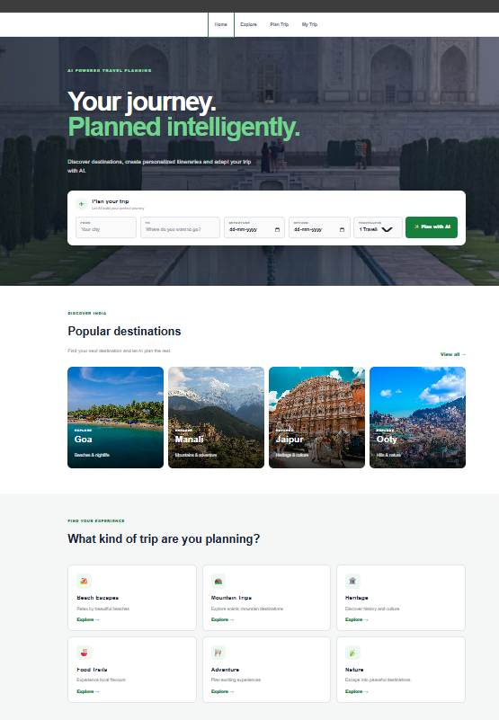
Result:

Slide 11
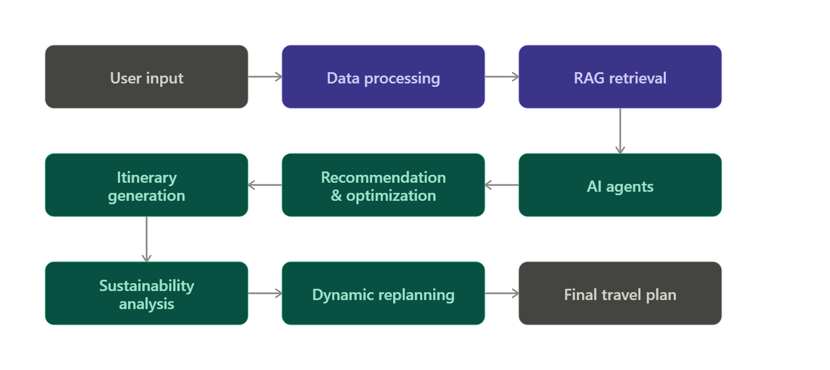
Project Title - Calibri body 18
Pipeline structure

